Slide 1

Agent Activity Chart
6/29/2022 9:46 PM
Print User : automation
Page 1 of 3

Slide 2
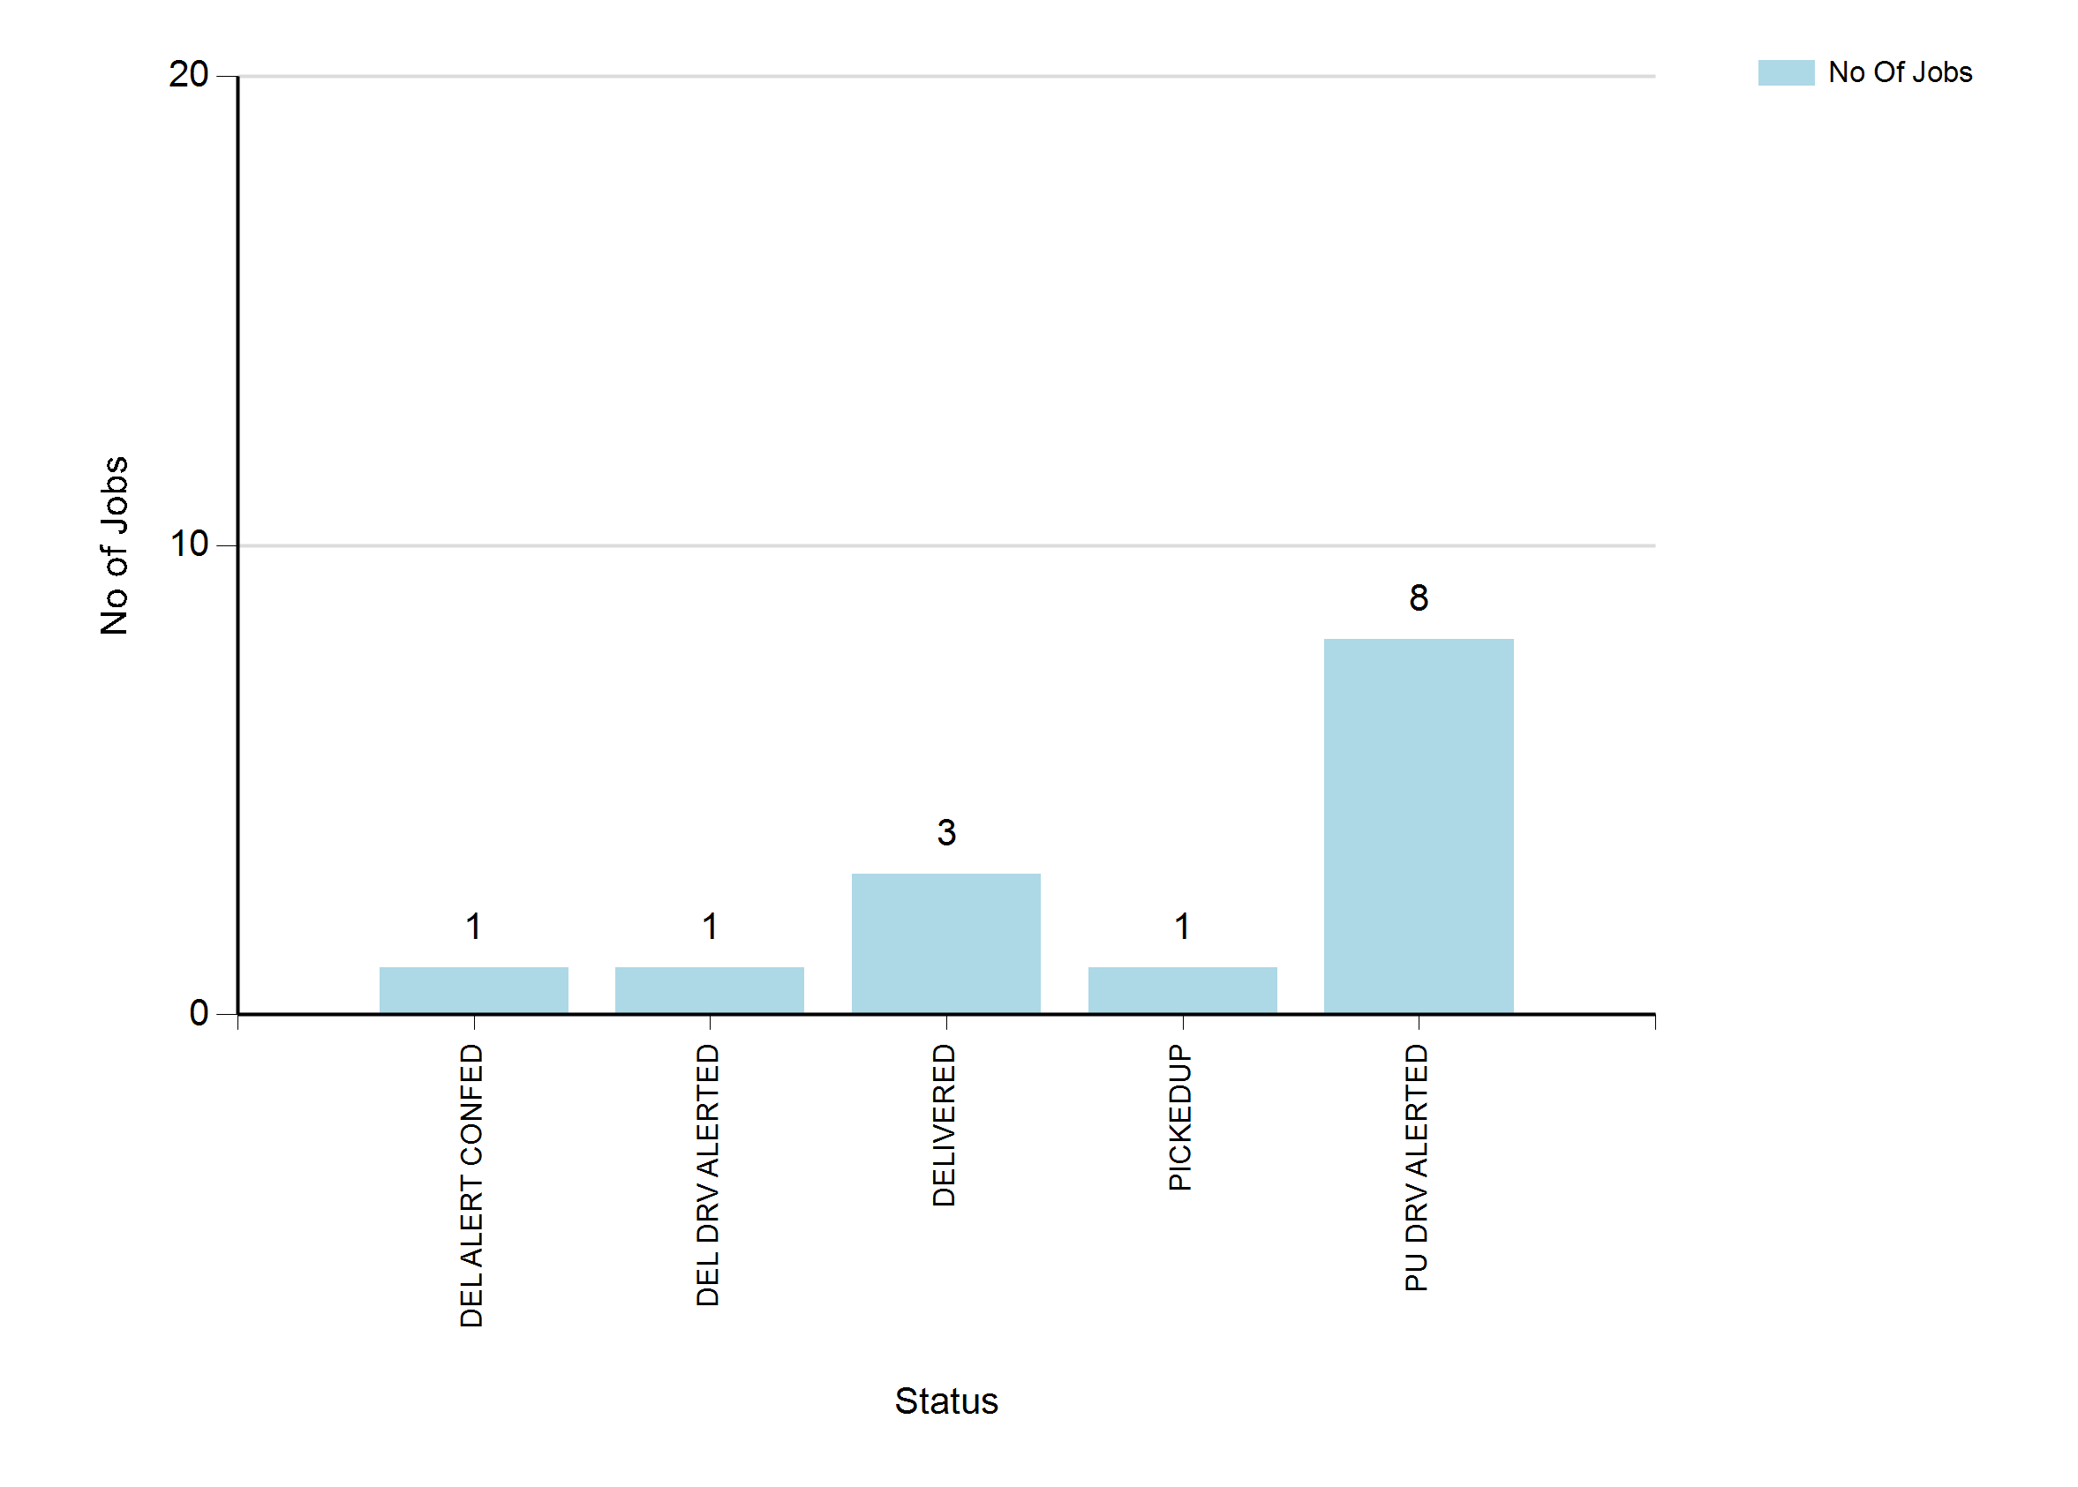
6/29/2022 9:46 PM
Print User : automation
Page 2 of 3

Slide 3
6/29/2022 9:46 PM
Print User : automation
Page 3 of 3

